Slide 1
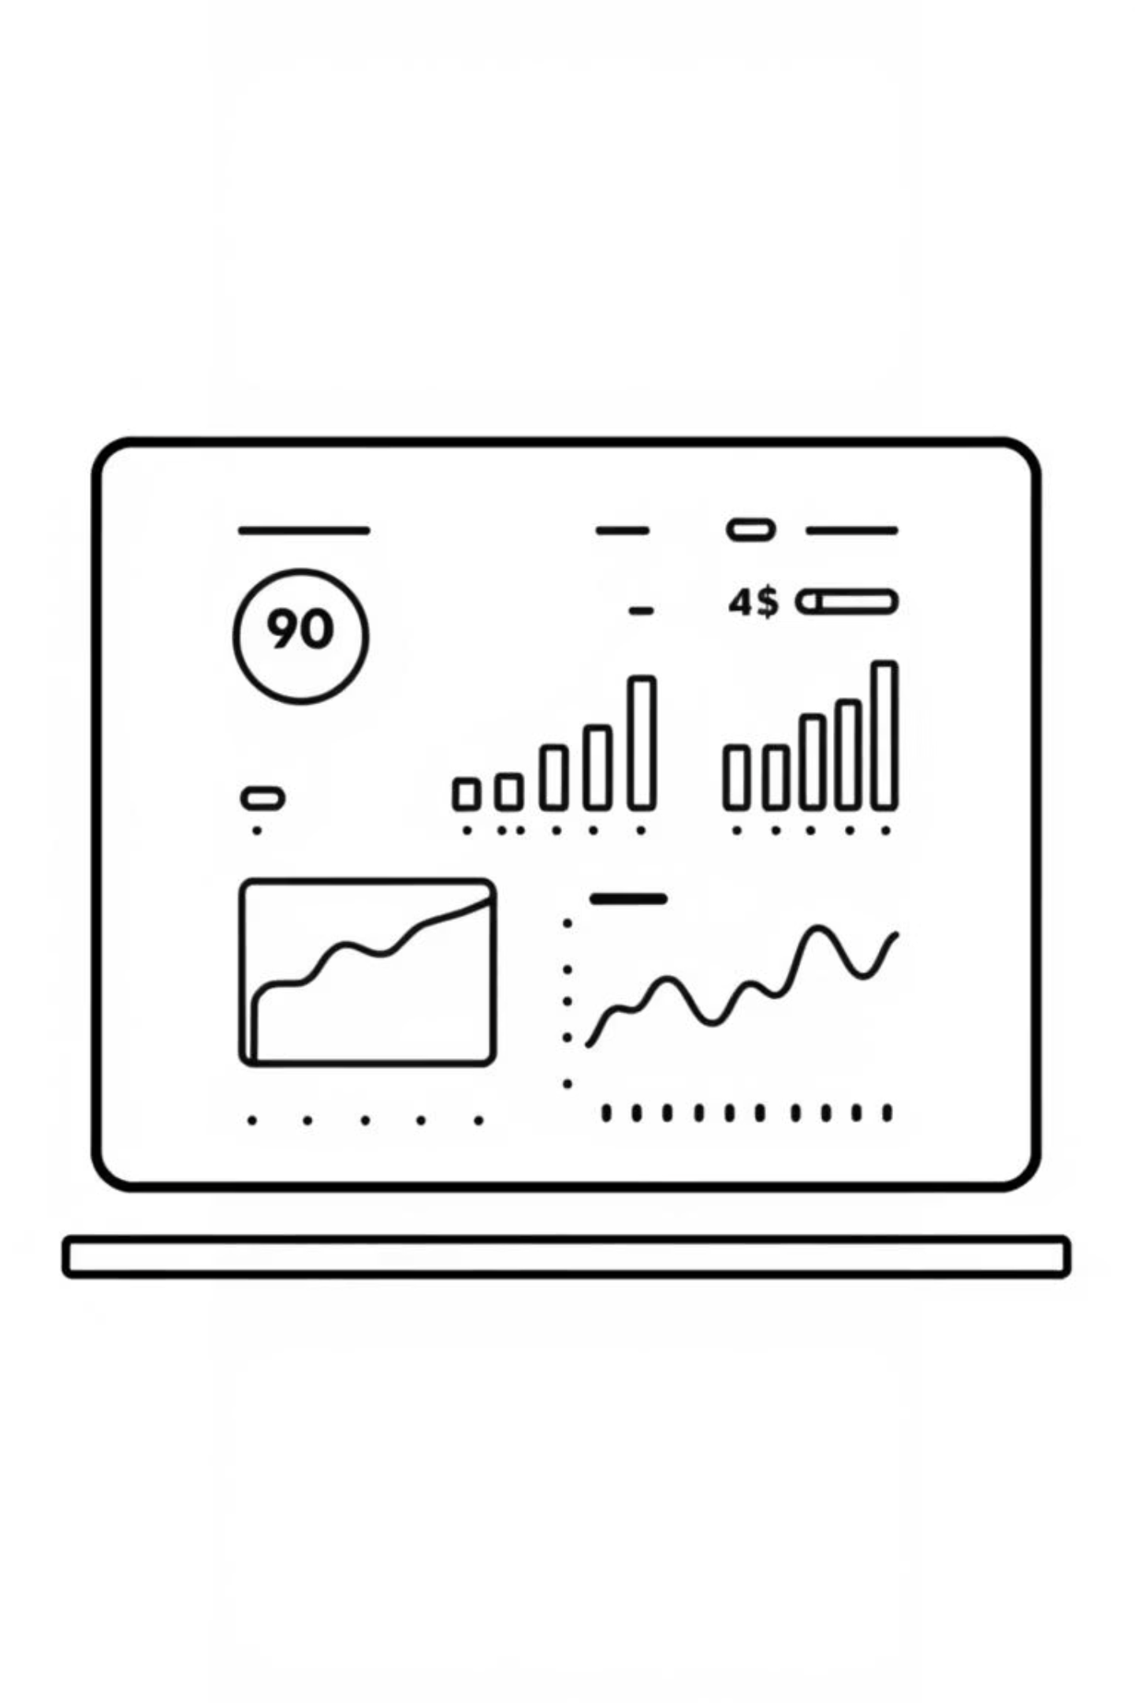

StoreSight
A Distributed System for Predicting Retail Sales
Smeet Nilvarna: 2007270 Nilesh Dusane: 2021621
Laboratory of Advanced Programming Project
Submitted to: Prof. Massimo Mecella

Slide 2
Agenda
1
Project Overview & Problem Statement
2
User Stories & Requirements
3
System Architecture & Technology Stack
4
Project Management & Estimation (SCRUM, FP, COCOMO II)
5
Implementation & Results

Slide 3

What is StoreSight?
StoreSight is a web platform that provides retailers with powerful inventory analytics to optimize stock management, transforming how businesses handle their product flow.
Utilizes machine learning to analyze historical data and identify complex patterns.
Built with a distributed architecture in mind, using a Flask API and Docker for scalability and easy deployment.
Goal: Help store managers optimize inventory, reduce waste, and increase revenue.

Slide 4
The Challenge: Why Sales Forecasting is Hard
Overstocking
Understocking
Financial Loss
Lost Sales
Product Waste
Poor Customer Experience
Tied-up Capital
Damaged Brand Loyalty

Slide 5
User Stories
We focused on key user roles to ensure StoreSight meets their critical needs, to simplify complex inventory tasks with interesting features.
Store Manager
1
As a Retail Manager, I want to get a sales forecast for a specific store and product family, so that I can make better decisions about inventory and staffing.

Slide 6
User Requirements (Functional)
The system shall allow a user to request a sales forecast based on store and product family.
The system shall process raw data by cleaning, imputing missing values, and performing feature engineering.
The system shall train and evaluate multiple machine learning regression models.
The system shall expose its prediction logic via a RESTful API.
The system shall display the final sales forecast to the user in a clear, tabular format.

Slide 7
User Requirements (Non-Functional)
Scalability: The application architecture must support future expansion to handle requests from multiple stores simultaneously.
Portability: The entire application must be containerized using Docker for consistent deployment across different environments.
Performance: The API should return a prediction in near-real-time (under 2 seconds).
Usability: The user interface must be simple and intuitive for a non-technical manager

Slide 8
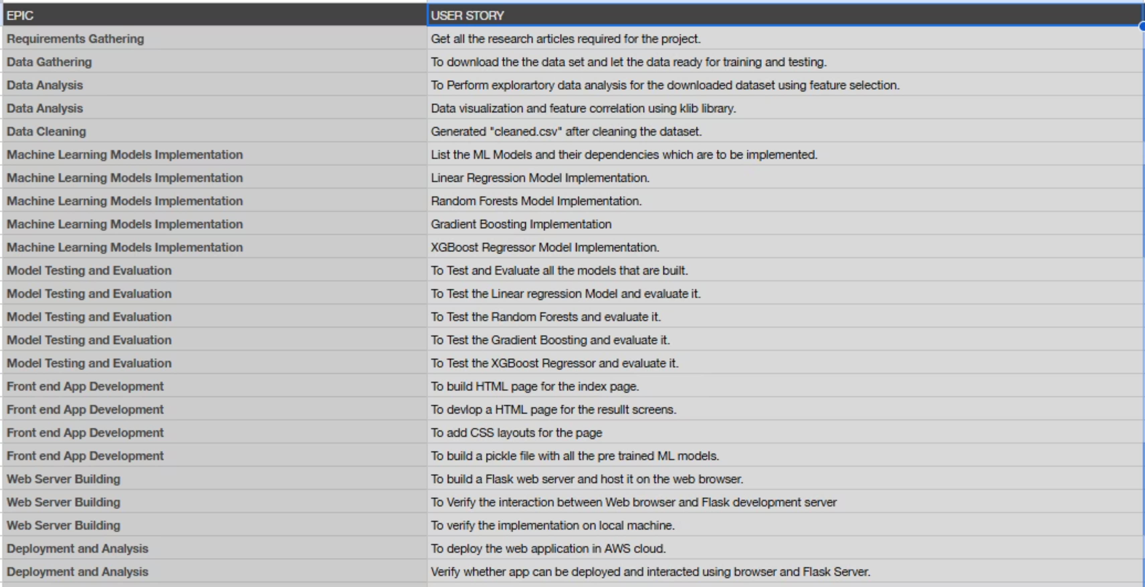

Slide 9

Application Methodology
Development / Training and Deployed Service on AWS.
3. Model Training & Comparison (Linear Regression, Random Forest, XGBoost)
1. Collect Data: Kaggle Big Mart Datasets
2. Data Cleaning & Feature Engineering
6. Added Deployment Details: AWS EC2 Instance hosts a Docker Container
4. Deploy Model: Serialized Model (model.pkl)
5. Flask API (/predict endpoint)
AWS EC2 Instance
Docker Container

Slide 10





Our Tech Stack
We carefully selected a powerful combination of technologies to build StoreSight, ensuring performance, scalability, and maintainability.
Frontend
Backend
DevOps
HTML, CSS, JavaScript
Python, Flask
Docker, Nginx
Hosting
AWS Cloud

Slide 11
Core Features & Functionality
StoreSight provides a comprehensive suite of features designed to empower retail managers with actionable insights and automated workflows.
Real-time Inventory Dashboard
Product Performance Analytics
A central, intuitive view showing current stock levels, detailed sales data, and essential product information, updated instantly.
Interactive charts and tables identify best-selling, worst-selling, and most profitable items, highlighting key performance indicators.
Automated Low-Stock Alerts
Sales Trend Analysis
An intelligent system notifies managers via the platform or email when inventory levels hit critical thresholds, preventing stockouts.
Visualizations display product sales over time, offering valuable insights for accurate demand forecasting and strategic planning.

Slide 12
Function Point Analysis
Our Function Point Analysis quantifies the functional size of StoreSight, providing a metrics-driven approach to project estimation.
Main ILFs
Products, Inventory, Sales Records
Example EI
Update Stock Level (triggers alerts)
Unadjusted Function Points (UFP)
120
Adjusted Function Points (AFP)
145
The final Adjusted Function Points (AFP) of 145 reflects the comprehensive scope of StoreSight's functionalities.

Slide 13
Function Point Analysis
To get a standardized measure of the project's size, we performed a Function Point Analysis.
Functional Breakdown (What the System Does)
Final Calculation (Adjusting for Complexity)
Unadjusted Function Points (UFP): 34
• User Interactions (Inputs/Outputs/Inquiries): 10 UFP
Value Adjustment Factor (VAF): 1.02 (Based on a Technical Complexity Score of 37)
• Internal Data Files (Model, Cleaned Data): 14 UFP
• External Data Interfaces (Kaggle CSVs): 10 UFP
Final Adjusted Function Points (FP): 35
Total Unadjusted Function Points (UFP) = 34
(34 UFP × 1.02 VAF = 34.68)

Slide 14
COCOMO II Effort Estimation
Using the COCOMO II model, we estimated the effort and timeline required for StoreSight's development, ensuring realistic project planning.
Estimated Person-Months
Projected Timeline
Software Size
1.8
3.6 Months
1,520 SLOC
This indicates the total labor effort required for development.
Based on a team of 2 developers, ensuring a focused and efficient development cycle.

Slide 15
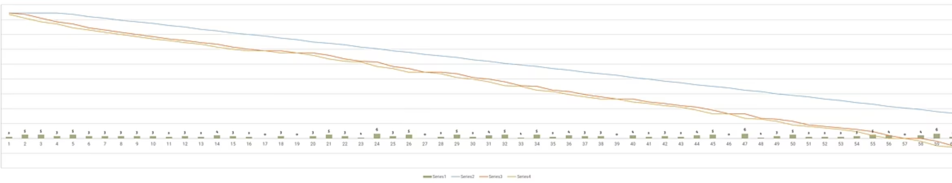
Our Development Process
We adopted the Scrum methodology to manage StoreSight's development, for a continuous delivery.
We worked in 2-week sprints, focusing on delivering one major feature or a set of related functionalities in each iteration.
Daily stand-ups, sprint reviews, and retrospectives ensured constant communication and adaptation throughout the project lifecycle.
The Burndown Chart visibly tracked our progress, allowing for transparent oversight and proactive adjustments to maintain project velocity.

Slide 16
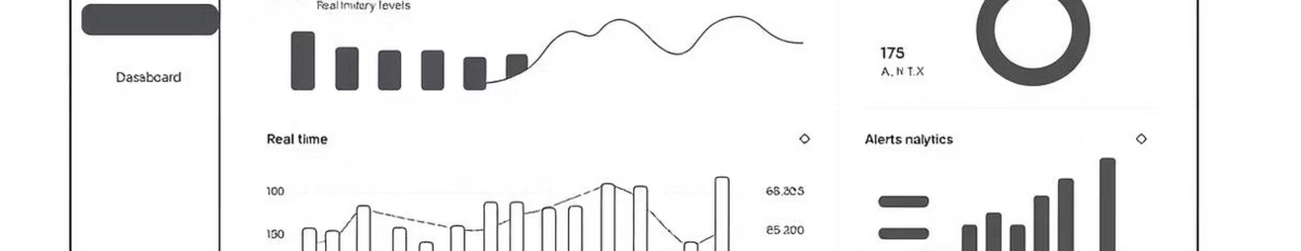
Live Demo
Now, let's see StoreSight in action! We'll walk you through the key features and functionalities we've discussed.
Prepare to see how StoreSight transforms raw data into actionable insights, providing retailers with the power to truly optimize their inventory management.

